Slide 1
Architectural Patterns-2
UNIT 5

Slide 2
Agenda
Introduction
Distributed Systems:
Broker
Interactive Systems:
Model-View-Controller (MVC)
Presentation-Abstraction-Control (PAC)

Slide 3
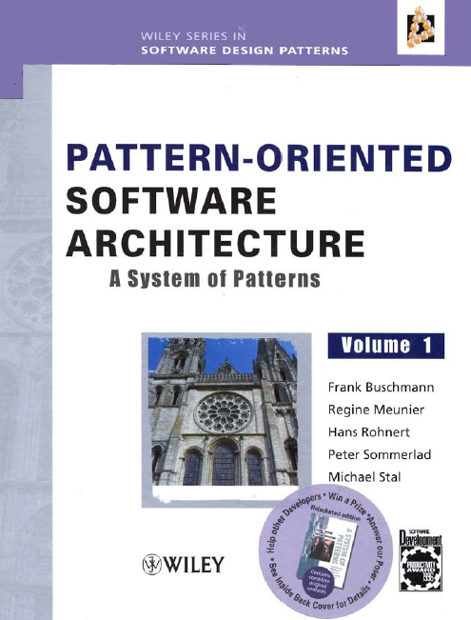
Reference

Slide 4
Introduction
There are two major trends in recent developments In hardware technology:
Computer systems with multiple CPUs are entering wen small offices, notably multiprocessing systems running operating systems such as IBM OS/2 Warp, Microsoft Windows NT, or UNIX.
Local area networks connecting hundreds of heterogeneous computers have become common place.
Benefits: Economics, Performance and Scalability, Inherent, Reliability.

Slide 5
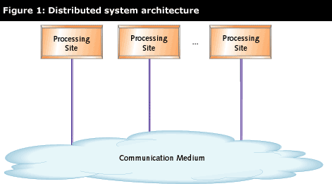
What is a Distributed Software System?
In contrast to centralized systems, distributed software systems add a new layer of complexity
A system with two or more independent processing sites that communicate with each other over a medium whose transmission delays may exceed the time between successive state changes.
By "distributed" we mean that the decisions are reached by consensus, with each site making its own decision according to the rules of the algorithm and the evidence presented by the other participating sites.

Slide 6
Broker
The broker architectural pattern can be used to structure distributed software systems with decoupled components that interact by remote service invocations.
A broker component is responsible for coordinating communication, such as requests, as well as for transmitting results and exceptions.

Slide 7

Concept - Structure with no distribution
The client invokes the performFunctionA method on the server directly.
This is possible only if the server objects reside on the same computer as the client objects

Slide 8
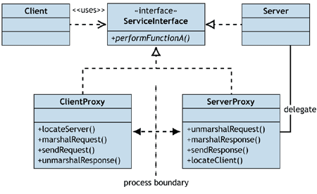
Structure with distribution
When implementing the distribution, client and server proxies would be added to handle all the "plumbing"
That is, sending a method invocation and its parameters across the network to the server and then sending the response back to the client

Slide 9
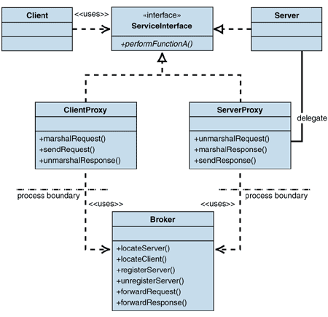
Structure with Broker

Slide 10
Example
Suppose we are developing a City Information System (CIS) designed to run on a wide area network. Some computers in the network host one or more services that maintain information about events, restaurants, hotels. historical monuments or public transportation.

Slide 11
What is expected?
We expect the system to change and grow continuously, so the individual services should be decoupled from each other.
In addition the terminal software should be able to access services without having to know their location
This allows us to move, replicate, or migrate services.
One solution is to install a separate network that connects all terminals and servers, leading to an intranet system
But intranet is limited to one network, so internet is better for global access.

Slide 12
Context
Your environment is a distributed and possibly heterogeneous system with independent cooperating components

Slide 13
Problem
Building a complex software system as a set of decoupled and interoperating components, rather than as a monolithic application, results in
greater flexibility
maintainability
changeability
By partitioning functionality into independent components the system becomes potentially distributable and scalable.
Services for adding, removing, exchanging, activating and locating components are also needed.

Slide 14
Broker Architecture
Components should be able to access services provided by others through remote, location-transparent service invocations.
You need to exchange, add, or remove components at run-time
The architecture should hide system- and implementation-specific details from the users of components and services.

Slide 15
Solution
Introduce a broker component to achieve better decoupling of clients and servers.
Servers register themselves with the broker, and make their services available to clients through method interfaces.
Clients access the functionality of servers by sending requests via the broker.
A broker's tasks include locating the appropriate server, forwarding the request to the server and transmitting results and exceptions back to the client.
By using the Broker pattern, an application can access distributed services simply by sending message calls to the appropriate object.

Slide 16
Structure
The Broker architectural pattern comprises six types of participating components:
Clients & servers
Brokers & bridges
Client-side proxies and server-side proxies.
CSI example – Server -> is a Web Server and Clients access server(s) thru’ http, CGI, etc.

Slide 17
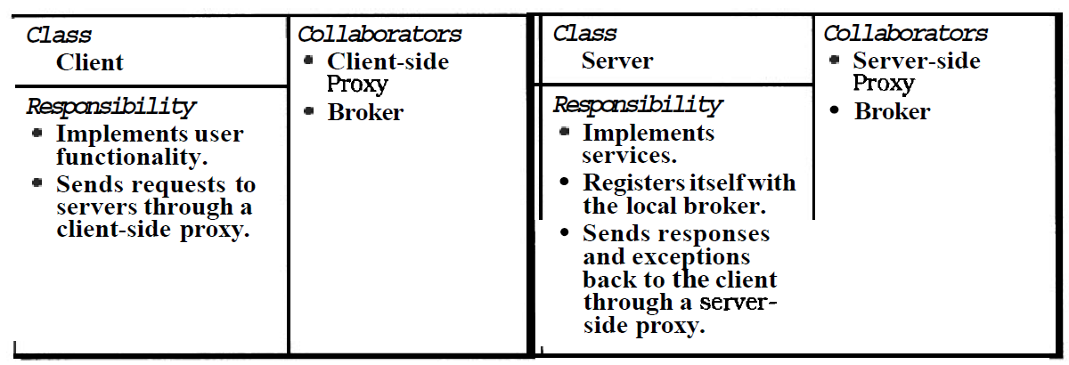
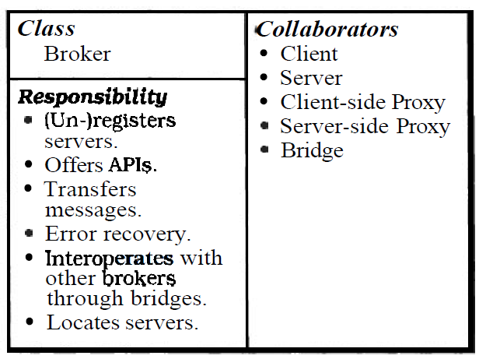
Contd.
A broker is a messenger that is responsible for the transmission of requests from clients to servers, as well as the transmission of responses and exceptions back to the client

Slide 18
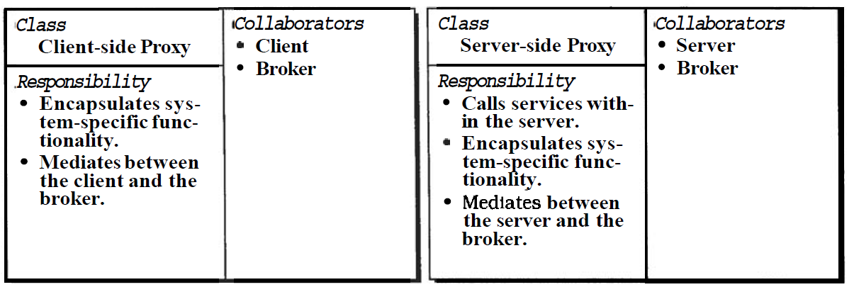
Proxies
This additional layer provides transparency, in that a remote object appears to the client as a local one.
Hiding of implementation details from the clients

Slide 19
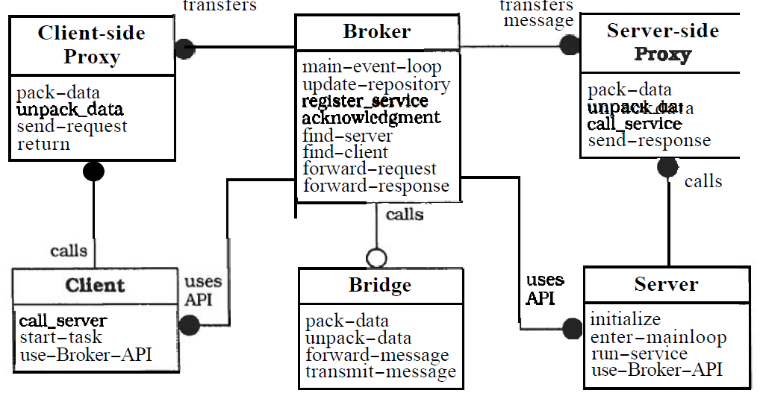
Objects in a Broker system

Slide 20
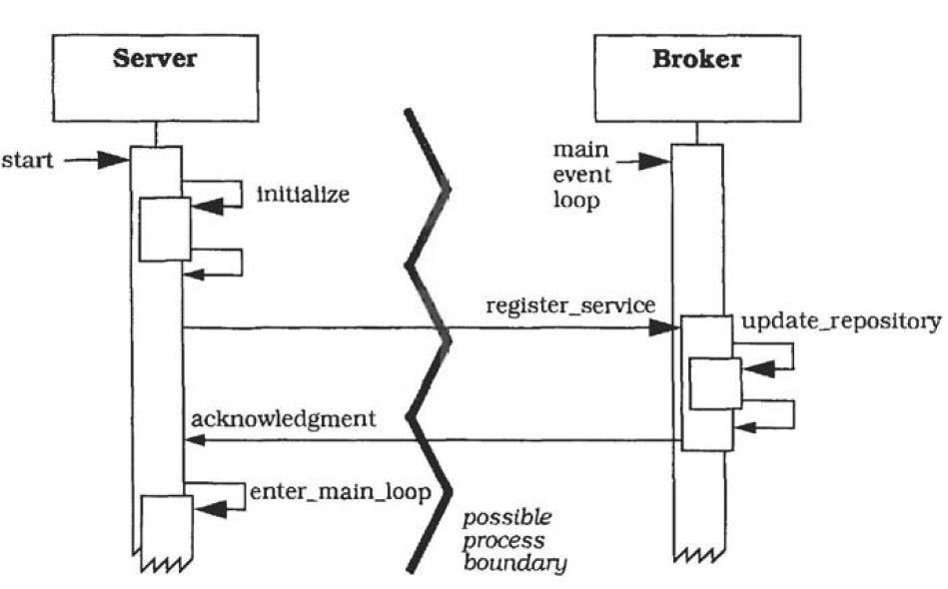
Dynamics – Scenario I
Illustrates the behavior when a server registers itself with the local broker component
Initialize Broker and Server
The server registers itself with the broker and receives an Acknowledgement.
Server enters its main loop waiting for incoming client requests.

Slide 21
Scenario II
Scenario II illustrates the behavior when a client sends a request to a local server.
Request goes to server via proxies and broker

Slide 22
Implementation
Define an object model, or use an existing model
Decide which kind of component-interoperability the system should offer.
Specify the APls the broker component provides for collaborating with clients and servers
Use proxy objects to hide implementation details from clients and sewers.
Design the broker component
Develop IDL compilers

Slide 23
Examples
Our example CIS system offers different kinds of services.
For Resolved example, a separate server workstation provides all the information related to public transport.
Another server is responsible for collecting and publishing information on vacant hotel rooms.
A tourist may be interested in retrieving information from several hotels, so we decide to provide this data on a single workstation.
Every hotel can connect to the workstation and perform updates. A tourist is capable of booking hotel rooms on-line from anywhere in the Internet using CGI scripts

Slide 24
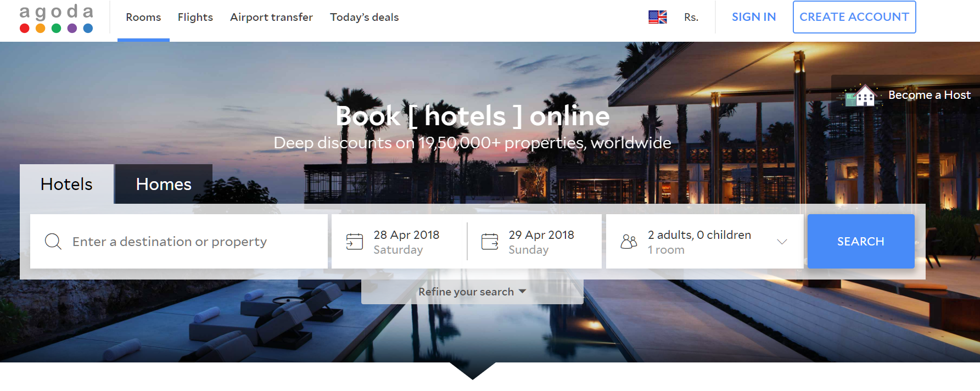
Agoda.com

Slide 25
Variants
Direct Communication Broker System
Message Passing Broker System
Trader System
Callback Broker System

Slide 26
Known Uses
CORBA
Common Object Request Broker Architecture (CORBA) defined by the Object Management Group (OMG).
IBM SOM/DSOM
The World Wide Web is the largest available Broker system in the world.
Consequences…..

Slide 27
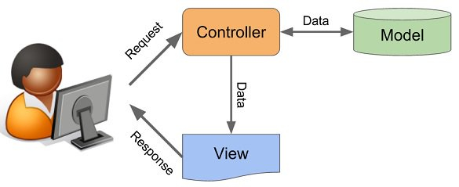
MVC

Slide 28
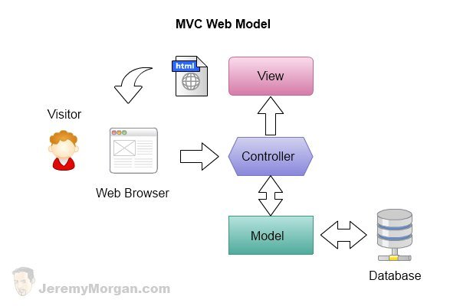
What is MVC?
The Model-View-Controller architectural pattern (MVC) divides an interactive application into three components.
The Model contains the core functionality and data.
Views display information to the user.
Controllers handle user input.
Views and controllers together comprise the user interface.

Slide 29
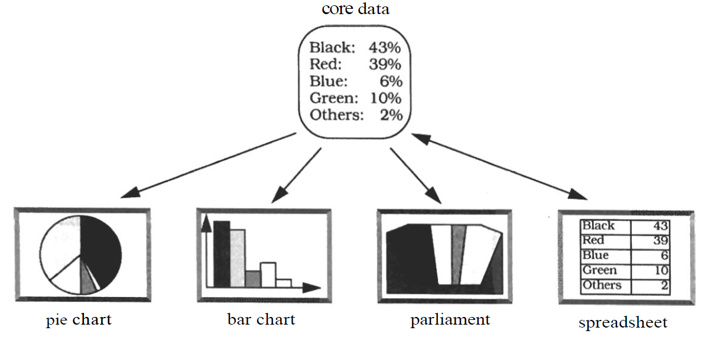
Example
Consider a simple information system for political elections with proportional representation.
This offers a spreadsheet for entering data and several kinds of tables and charts for presenting the current results.
Users can interact with the system via a graphical interface.
All information displays must reflect changes to the voting data immediately.

Slide 30
Context & Problem
Interactive applications with a flexible human-computer interface.
Problem
User interfaces are especially prone to change requests – add new features leads to menu alteration
System may need to be ported to another platform with a different 'look and feel' standard
A typist enters information into forms via the keyboard. A manager wants to use the same system mainly by clicking icons and buttons

Slide 31
Forces
The following forces influence the solution:
The same information is presented differently in different windows, for example, in a bar or pie chart.
The display and behavior of the application must reflect data manipulations immediately.
Changes to the user interface should be easy, and even possible at run-time.
Supporting different 'look and feel' standards or porting the user interface should not affect code in the core of the application.

Slide 32
Solution - MVC
MVC divides an interactive application into the three areas: processing, output, and input
The model component encapsulates core data and functionality. The model is independent of specific output representations or input behavior.
View components display information to the user. A view obtains the data from the model. There can be multiple views of the model.
Controllers receive input, usually as events that encode mouse movement, activation of mouse buttons, or keyboard input. Events are translated to service requests for the model or the view. The user interacts with the system solely through controllers.

Slide 33
Structure

Slide 34
Object Model

Slide 35
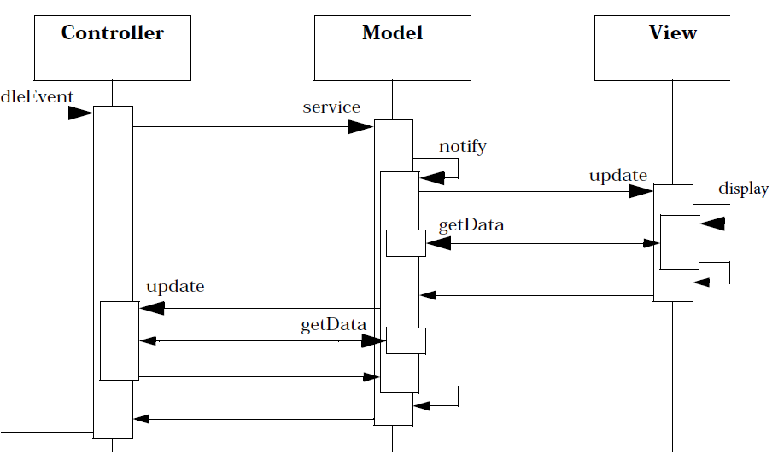
Dynamics
Scenario I: shows how user input that results in changes to the model triggers the change-propagation mechanism

Slide 36
Implementation
Separate human-computer interaction from core functionality
Implement the change-propagation mechanism
Design and implement the views.
Design and implement the controllers
Design and implement the view-controller relationship
‘Pluggable’ controllers.
Infrastructure for hierarchical views and controllers
Further decoupling from system dependencies.

Slide 37
Presentation-Abstraction-Control (PAC)

Slide 38
Introduction
The Presentation-Abstraction-Control architectural pattern (PAC) defines a structure for interactive software systems in the form of a hierarchy of cooperating agents.
Every agent is responsible for a specific aspect of the application's functionality and consists of three components: presentation, abstraction, and control.
This subdivision separates the human-computer interaction aspects of the agent from its functional core and its communication with other agents.

Slide 39
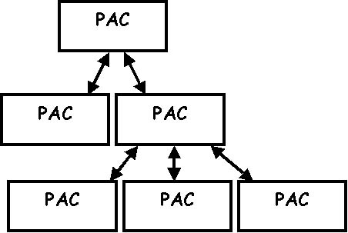
MVC Vs. PAC
The MVC is restricted to simple GUI's with one or more views on the same model.
If the model consists of substructures that all require they own special way of interaction, a more complex GUI architecture is in order.
Each PAC component consists of these items:
Presentation
Abstraction
Control

Slide 40
More on PAC
Control is somewhat similar to the Controller in the MVC architecture. It processes external events and updates the model. It also directly updates the Presentation part. Yet it is different from the C in MVC in that it passes the changes being made to its parent PAC component.
Abstraction contains the data, like in MVC. However, it may be just part of the complete data structure of the application, and it does not play an active role in the notification of changes.
Presentation is exactly like the View of MVC. It displays the information from the Abstraction.

Slide 41
Example
A simple information system for political elections with proportional representation.
This offers a spreadsheet for entering data and several kinds of tables and charts for presenting current standings. Users interact with the software through a graphical interface

Slide 42
Context
Development of an interactive application with the help of agents

Slide 43
Problem
Horizontal & vertical decomposition of system functionality
Agents specialized in human-computer interaction accept user input and display data
Other agents maintain the data model of the system and offer functionality that operates on this data
Additional agents are responsible for diverse tasks such as error handling or communication with other software systems.

Slide 44
Solution
Structure the interactive application as a tree-like hierarchy of PAC agents.
The agent's presentation component provides the visible behavior of the PAC agent.
Its abstraction component maintains the data model that underlies the agent, and provides functionality that operates on this data.
Its control component connects the presentation and abstraction components, and provides functionality that allows the agent to communicate with other PAC agents

Slide 45
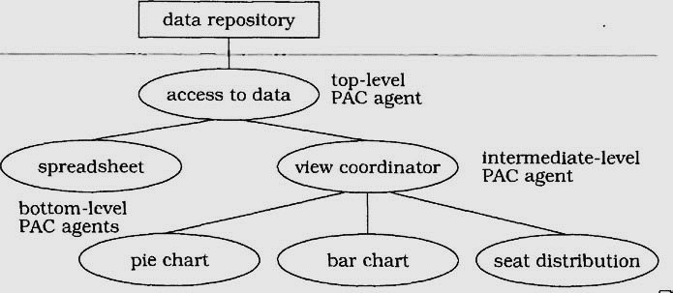
Example

Slide 46
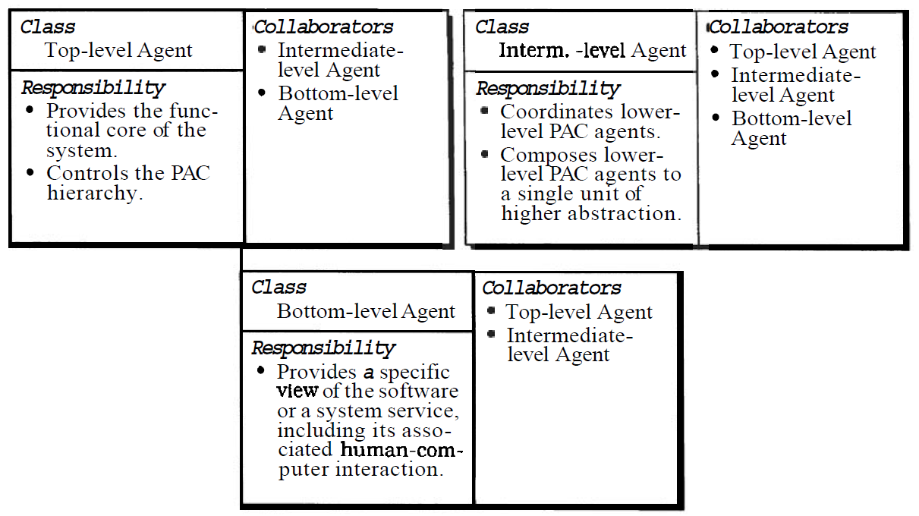
Structure

Slide 47
PAC - Political Elections

Slide 48
Internal Structure of View Co-ordinator

Slide 49
Dynamics
Scenario I: describes the cooperation between different PAC agents when opening a new bar-chart view of the election data.

Slide 50
Contd.
Scenario II shows the behavior of the system after new election data is entered, providing a closer look at the internal behavior of the top level PAC agent
The user enters new data into a spreadsheet. The control component of the spreadsheet agent forwards this data to the top level PAC agent.
It tells the top-level abstraction to change the data repository accordingly. The abstraction component of the top-level agent asks its control component to update all agents that depend on the new data.
The control component of the top-level PAC agent therefore notifies the view coordinator agent. The control component of the view coordinator agent forwards the change notification to all view PAC agents it is responsible for coordinating.

Slide 51
Contd.

Slide 52
Implementation
Define a model of the application - proper decomposition and organization of the application domain.
Define a general strategy for organizing the PAC hierarchy
Specify the top-level PAC agent
Specify the bottom-level PAC agents
Specify bottom-level PAC agents for system services
Specify intermediate-level PAC agents to compose lower-level PAC agents.
Specify intermediate-level PAC agents to coordinate lower-level PAC agents.
Separate core functionality from human-computer interaction & Link the hierarchy together

Slide 53
Known Uses
Network Traffic Management
Mobile Robot
Consequences - Benefits:
Separation of concerns
Support for change and extension
Support for multi-tasking
Consequences - Benefits:
Increased system complexity
Complex control component
Efficiency

Slide 54
Summary

